Slide 1
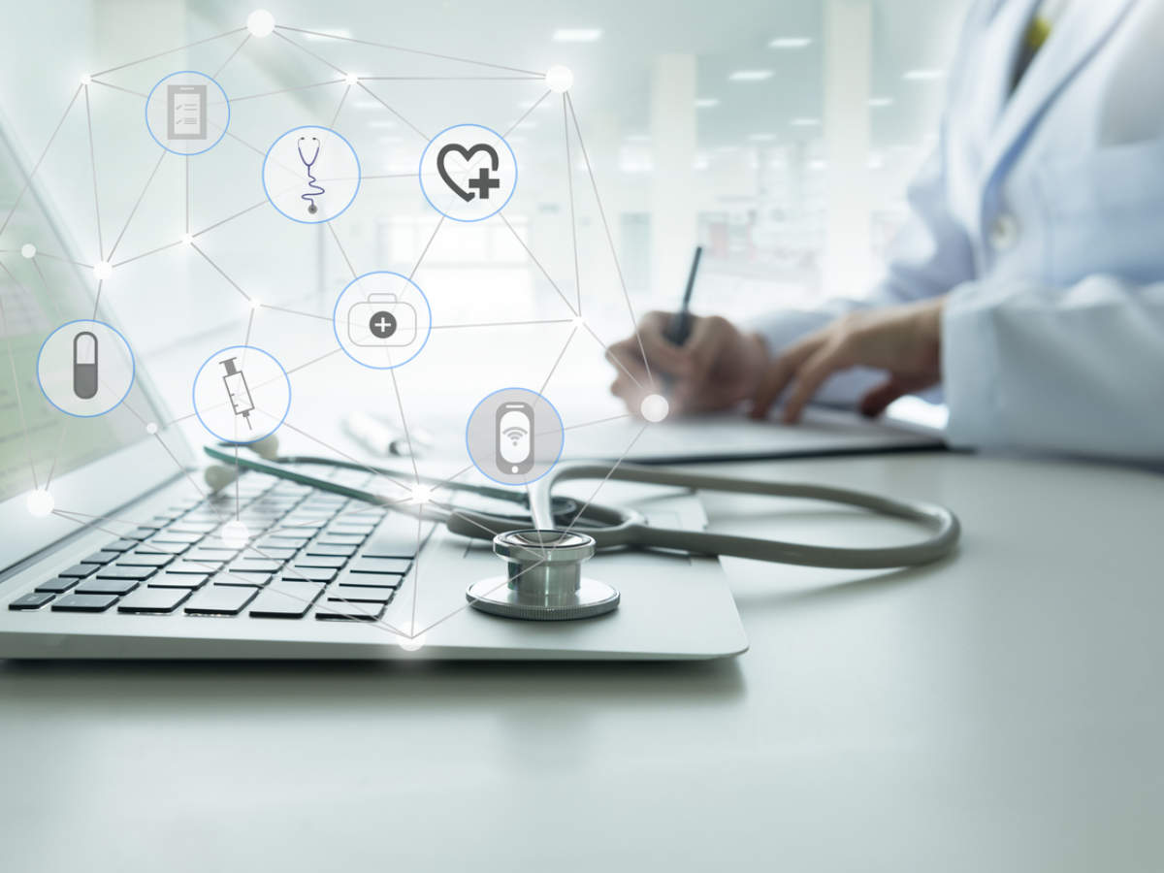
SMART HEALTH DISEASE PREDICTION SYSTEM

Slide 2

Guided By: Presented By:
Prof. Venus Patel Alay Patel
Sani Patel
Kashyap Raval

Slide 3
INTRODUCTION
It might have happened so many times that you or someone yours need doctors help immediately, but they are not available due to some reason. The Health Prediction system is an end user support and online consultation project. Here we propose a system that allows users to get instant guidance on their health issues through an intelligent health care system online. The system is fed with various symptoms and the disease/illness associated with those systems. The system allows user to share their symptoms and issues. It then processes user’s symptoms to check for various illnesses that could be associated with it. Here we use some intelligent data mining techniques to guess the most accurate illness that could be associated with patient’s symptoms.

Slide 4
INTRODUCTION(continue…)
In doctor module when doctor login to the system doctor can view his patient details and the report of that patient. Doctor can view details about the patient search what patient searched for according to their prediction. Doctor can view his personal details. Admin can add new disease details by specifying the type and symptoms of the disease into the database. Based on the name of the disease and symptom the data mining algorithm works. Admin can view various disease and symptoms stored in database. This system will provide proper guidance when the user specifies the symptoms of his illness.

Slide 5
OBJECTIVE
The objective of this project entitled “Smart health disease prediction using machine learning” is to provide a user friendly and easily understandable GUI to users to easily get instant guidance on their health issues through an intelligent health care system online. The main objective of the System is to predict disease according to symptoms and also suggest list of doctors and medicines.

Slide 6
GOAL
User can search for doctor’s help at any point of time.
User can talk about their illness and get instant diagnosis.
Informs the user about the type of disease or disorder it feels.
Doctors get more clients online.

Slide 7
NEED OF THE SYSTEM
There is always a need of a system that will provide the disease information according to symptoms shared by user.
This system will help the user to find good doctors and medicines.

Slide 8
MODULES
Patient Login: - Patient Login to the system using his ID and Password.
Patient Registration: -If Patient is a new user he will enter his personal details and he will user Id and password through which he can login to the system.
My Details: - Patient can view his personal details.
Disease Prediction: - Patient will specify the symptoms caused due to his illness. System will ask certain question regarding his illness and system predict the disease based on the symptoms specified by the patient and system will also suggest doctors based on the disease.

Slide 9
MODULES
Search Doctor:- Patient can search for doctor by specifying name, address or type.
Feedback:-Patient will give feedback this will be reported to the admin.
Doctor Login: - Doctor will access the system using his User ID and Password.
Patient Details: Doctor can view patient’s personal details.
Notification: Doctor will get notification how many people had accessed the system and what all are the diseases predicted by the system.

Slide 10
MODULES
Admin Login: Admin can login to the system using his ID and Password.
Add Doctor: Admin can add new doctor details into the database.
Add Dataset: Admin can add dataset file in database. View Doctor: Admin can view various Doctors along with their personal details.
View Disease: Admin can view various diseases details stored in database.
View Patient: Admin can view various patient details who had accessed the system.
View Feedback: Admin can view feedback provided by various users.

Slide 11
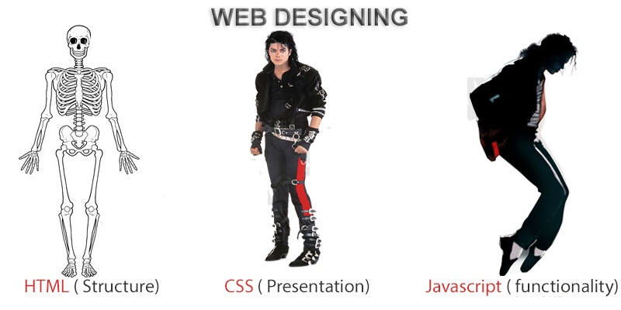
FRONTEND (LANGUAGE USED)
HTML (HYPERTEXT MARKUP LANGUAGE)
CSS (CASCADING STYLE SHEET)
BOOTSTRAP (FRAMEWORK OF CSS AND JS)

Slide 12

BACKEND
PYTHON DJANGO
SQLITE (DATABASE)

Slide 13
SOFTWARE USED
PYTHON INTERPRETER
PYCHARM IDE (INTEGRATED DEVELOPMENT ENVIRONMENT)
NOTEPAD++ OR ANY OTHER TEXT EDITOR
CHROME OR ANY OTHER BROWSER

Slide 14
ML ALGORITHMS USED
GAUSSIAN NAÏVE BAYES CLASSIFIER
RANDOM FOREST CLASSIFIER
SUPPORT VECTOR CLASSIFIER

Slide 15
PROJECT SCOPE
The project has a wide scope, as it is not intended to a particular organization. This project is going to develop generic software, which can be applied by any businesses organization. More over it provides facility to its users. Also the software is going to provide a huge amount of summary data.

Slide 16
PROPOSED SYSTEM
To beat the downside of existing framework we have created smart health prediction System. We have built up a specialist framework called Smart Health Prediction framework, which is utilized for improving the task of specialists. A framework checks a patient at initial level and proposes the possible diseases. It begins with getting some information about manifestations to the patient, in the event that the framework can distinguish the fitting sickness, at that point it proposes a specialist accessible to the patient in the closest conceivable territory.

Slide 17
PROPOSED SYSTEM (continue…)
On the off chance that the framework isn't sufficiently sure, it asks few questions to the patients, still on the off chance that the framework isn't sure; at that point it will show a few tests to the patient. In light of accessible total data, the framework will demonstrate the result. Here we utilize some intelligent methods to figure the most precise disorder that could be associated with patient's appearances and dependent on the database of a couple of patients restorative record, calculation (Naive Bayes) is connected for mapping the side effects with conceivable diseases. This framework improves undertaking of the specialists as well as helps the patients by giving vital help at a soonest organize conceivable.

Slide 18
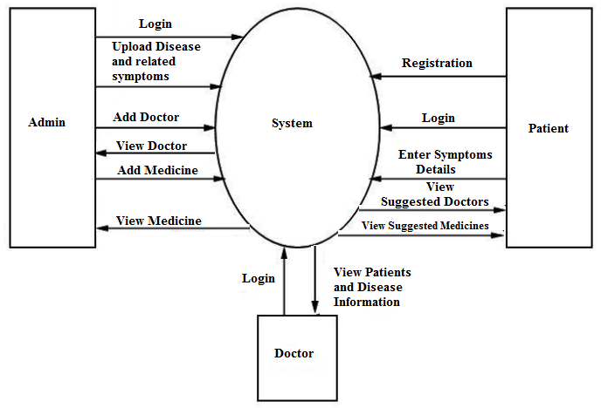
DFD(DATA FLOW DIAGRAM)

Slide 19
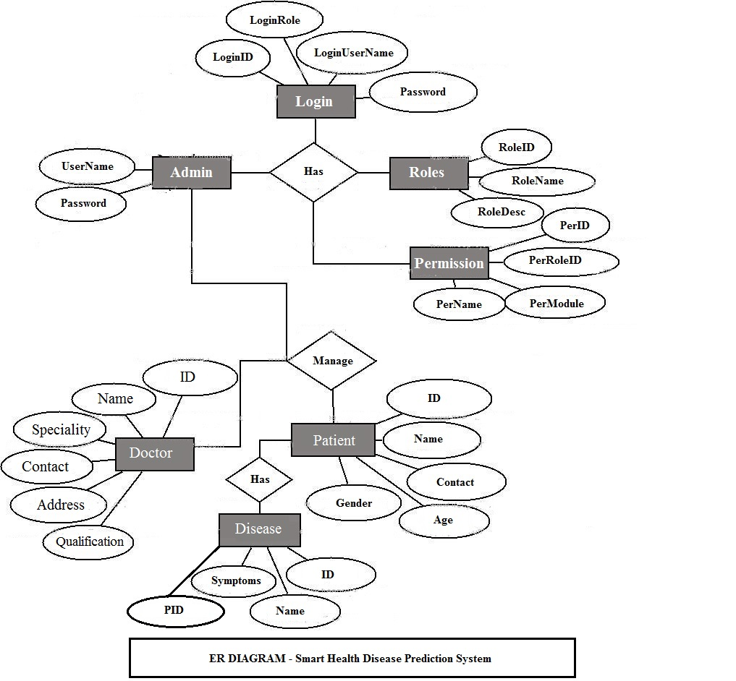
ER DIAGRAM

Slide 20
USE CASE DIAGRAM
Use case diagram consists of use cases and actors and shows the interaction between them. The key points are:
The main purpose is to show the interaction between the use cases and the actor.
To represent the system requirement from user’s perspective.
The use cases are the functions that are to be performed in the module.
An actor could be the end-user of the system or an external system.

Slide 21
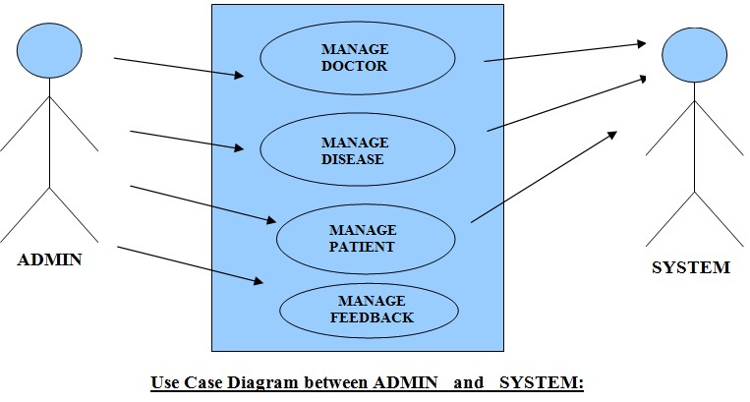
USE CASE DIAGRAM

Slide 22
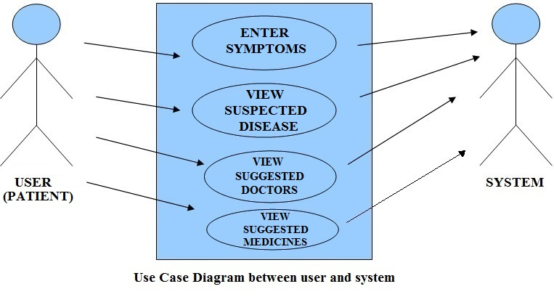
USE CASE DIAGRAM

Slide 23
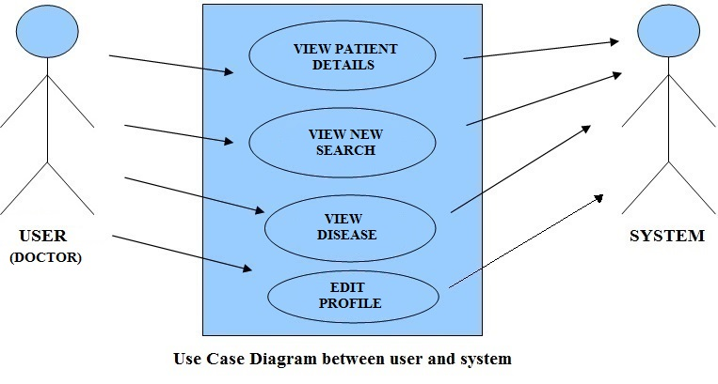
USE CASE DIAGRAM

Slide 24
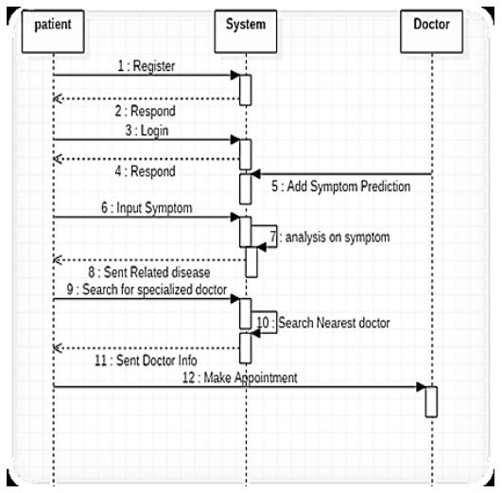
ACTIVITY DIAGRAM

Slide 25
SEQUENCE DIAGRAM
Login
Application
Database
Login
:Request
:Validate()
:executeQuery()
Response
Show Result
Failed:show()

Slide 26
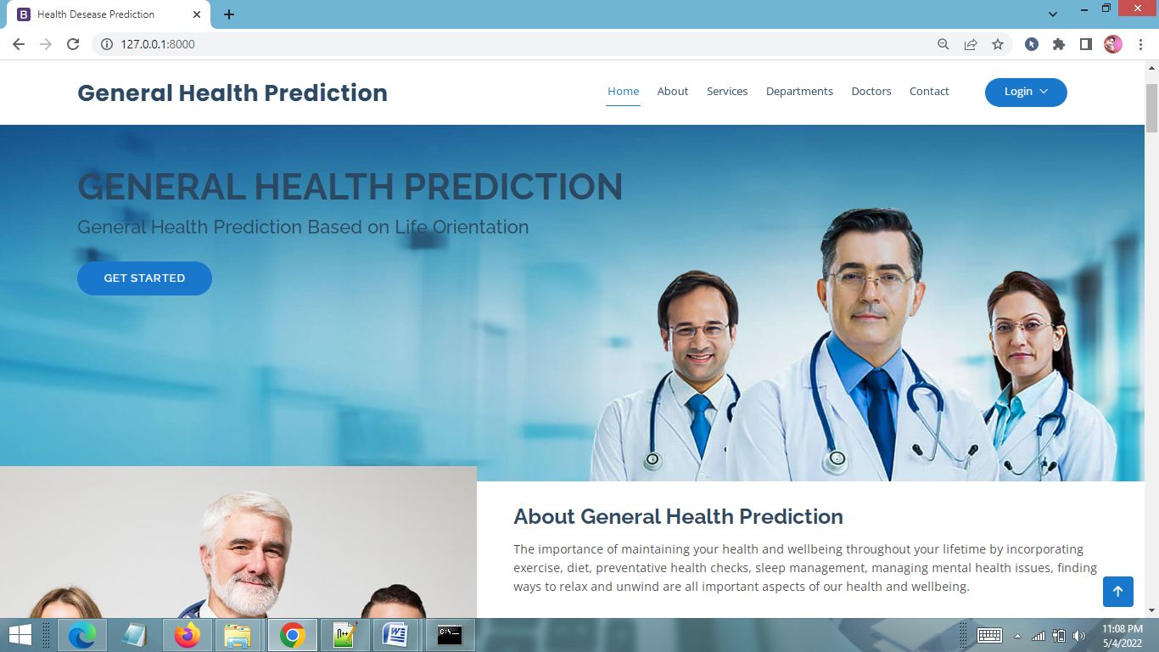
HOME PAGE

Slide 27
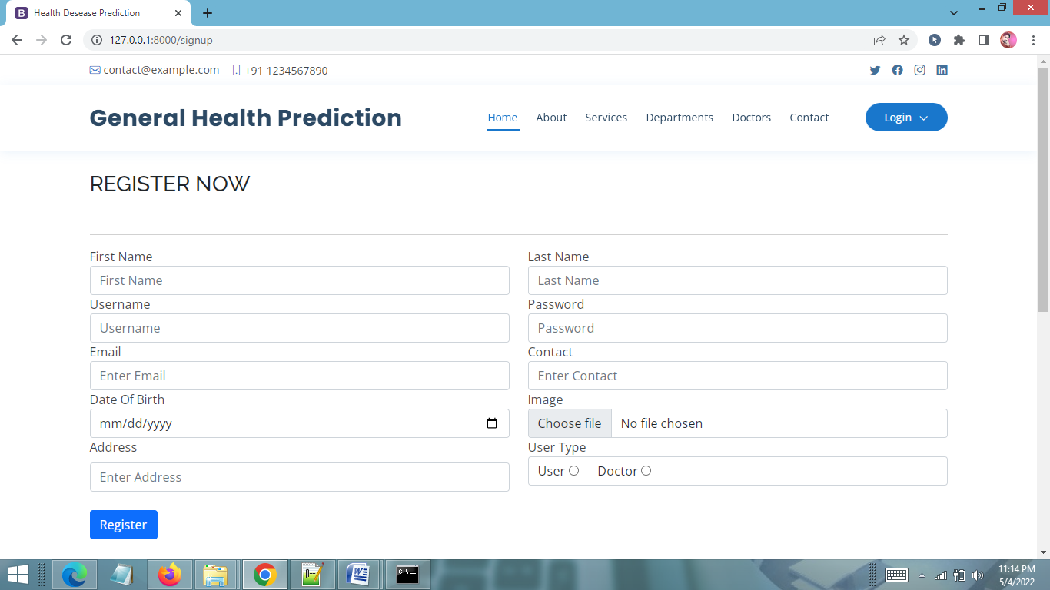
USER REGISTRATION PAGE

Slide 28
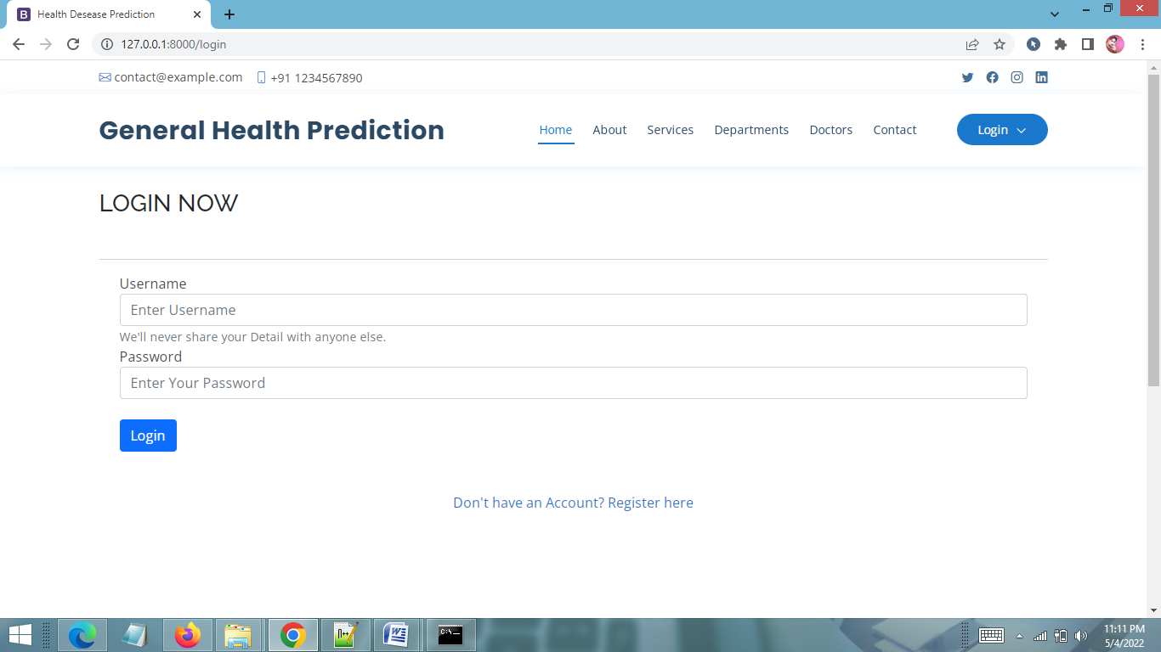
LOGIN PAGE

Slide 29
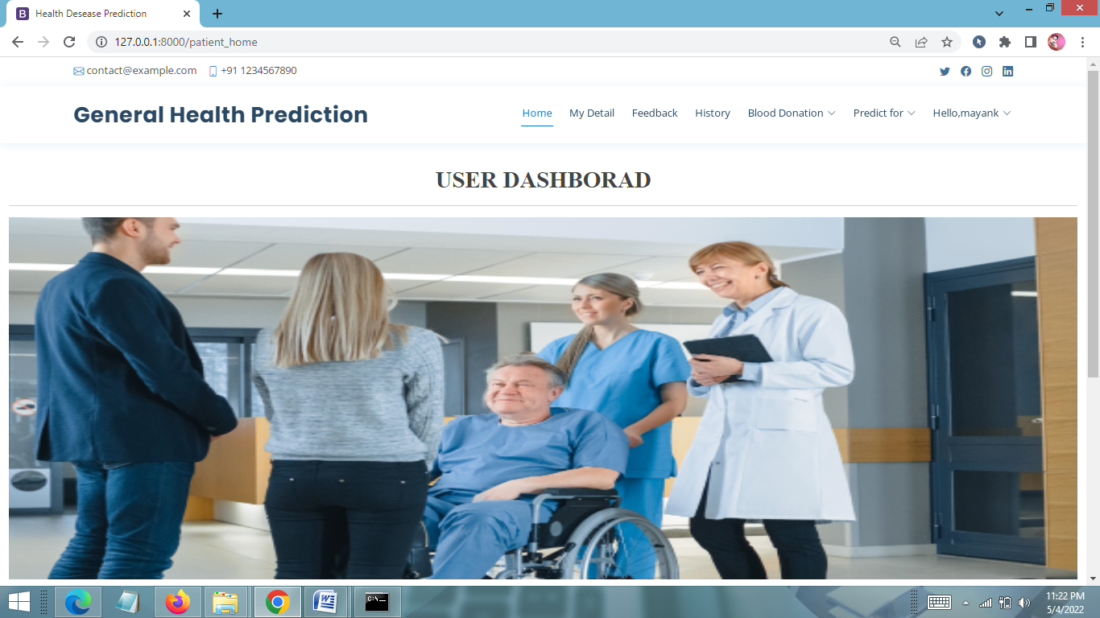
PATIENT HOME PAGE

Slide 30
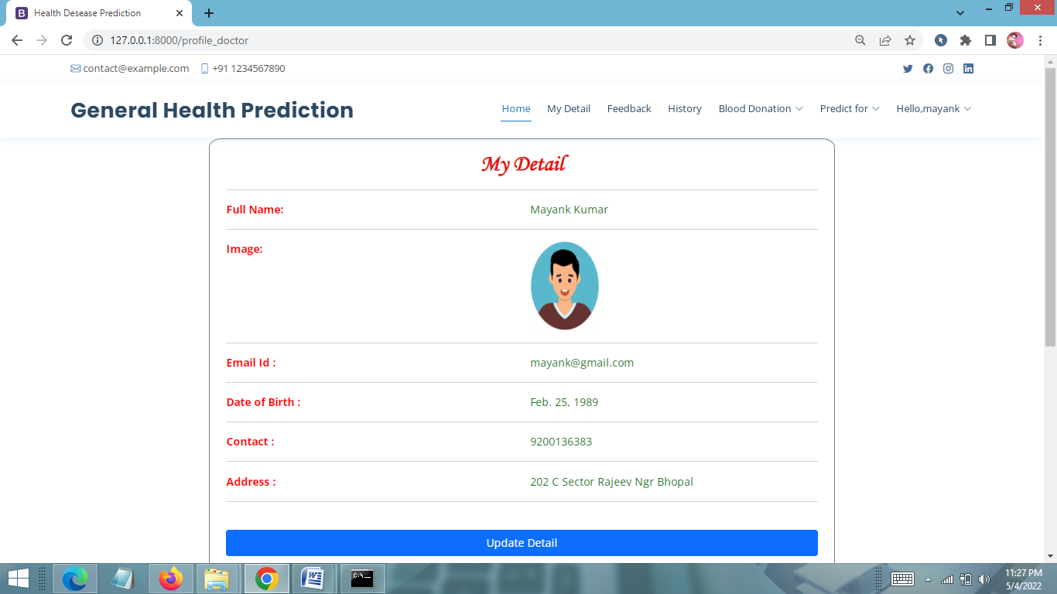
USER PROFILE PAGE

Slide 31
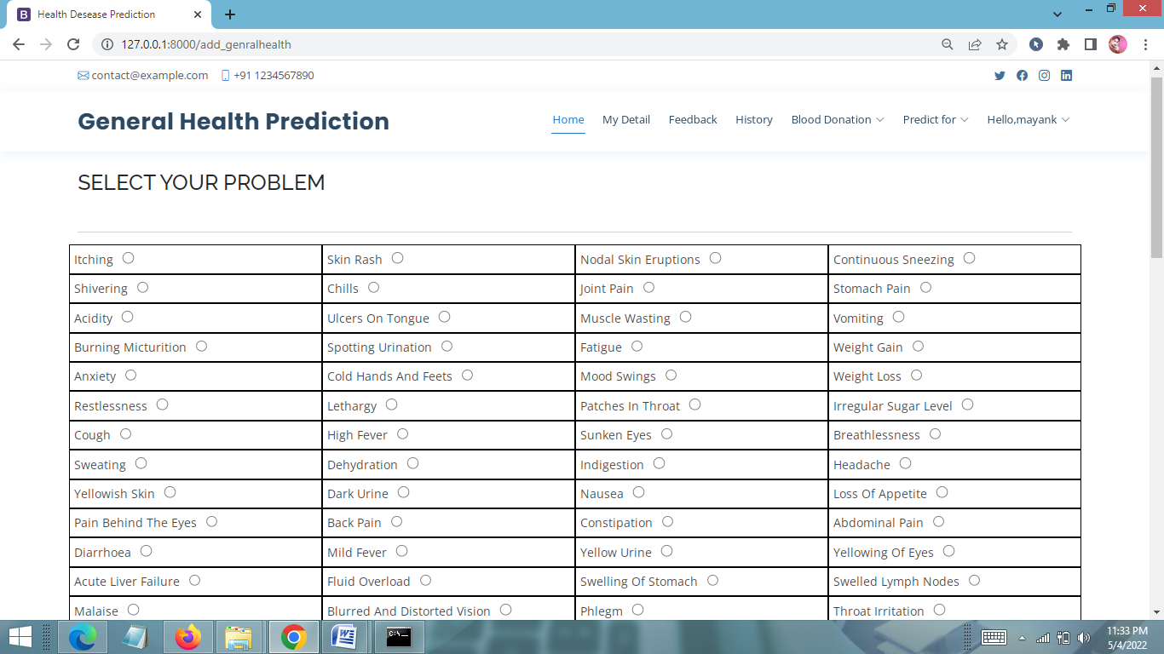
INPUT USER HEALTH PARAMETERS PAGE

Slide 32
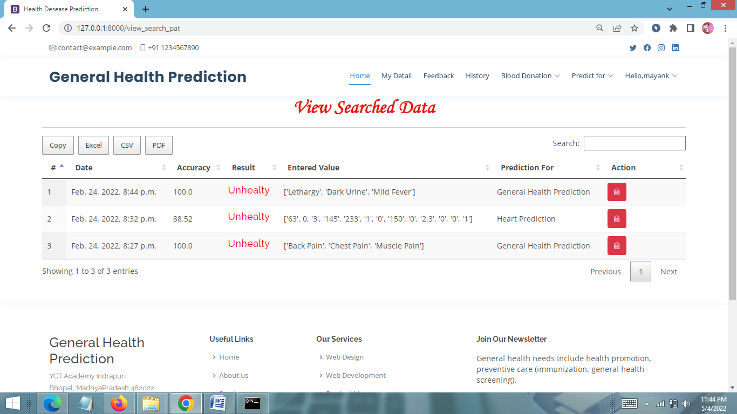
VIEW PREDICTION HISTORY PAGE

Slide 33
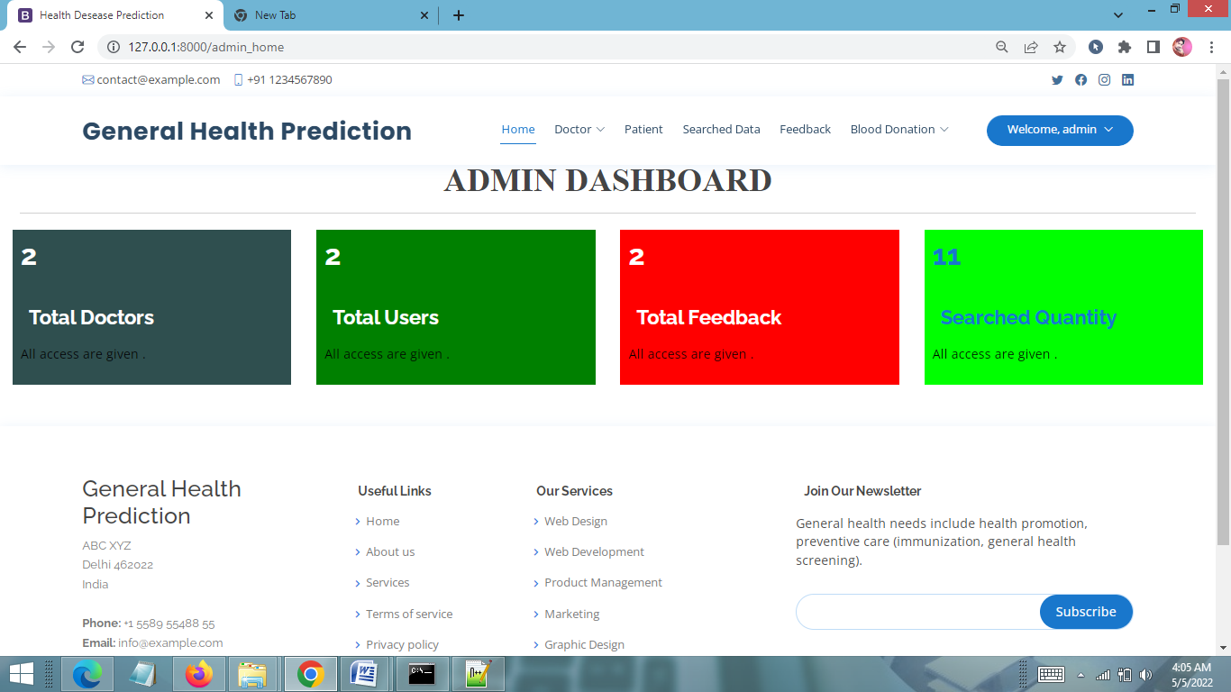
ADMIN HOME PAGE

Slide 34
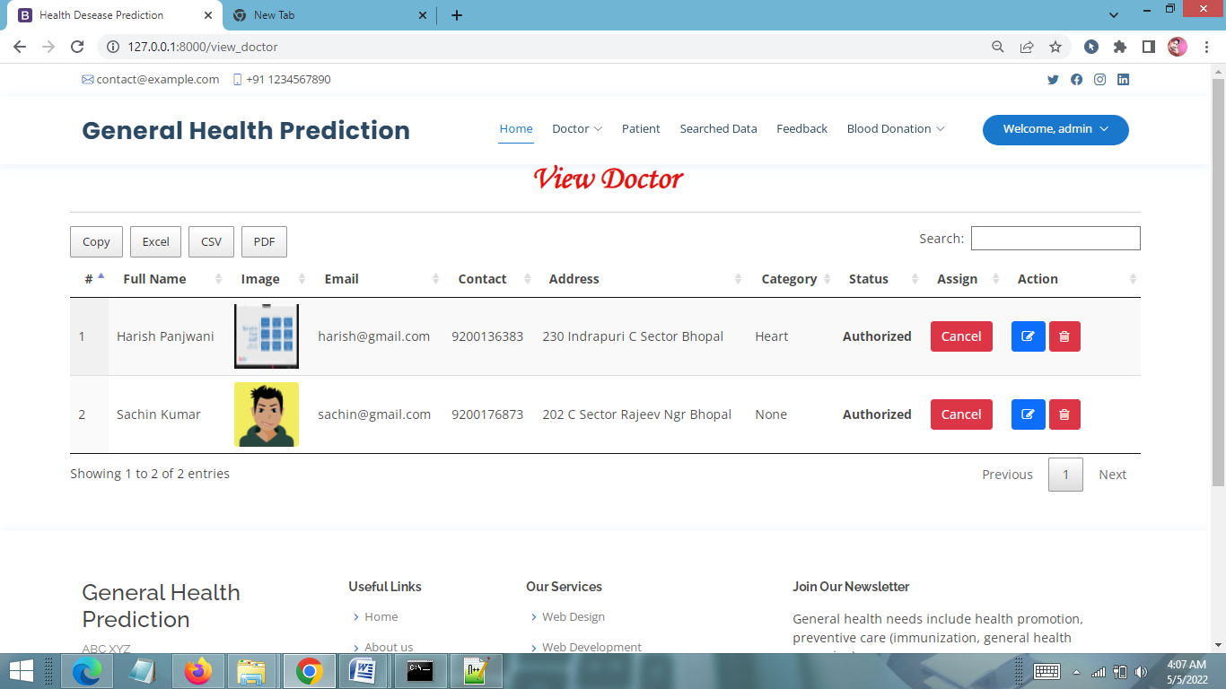
VIEW DOCTOR PAGE

Slide 35
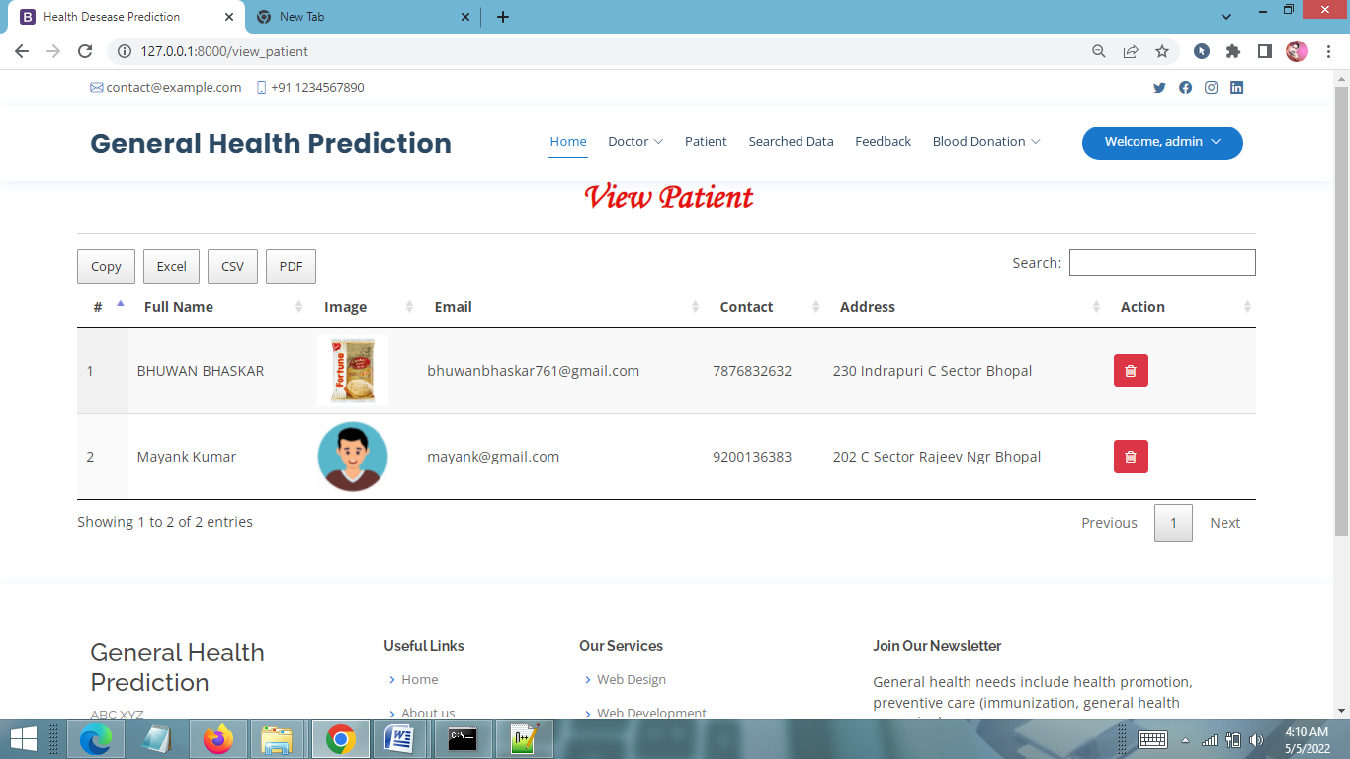
VIEW PATIENT PAGE

Slide 36
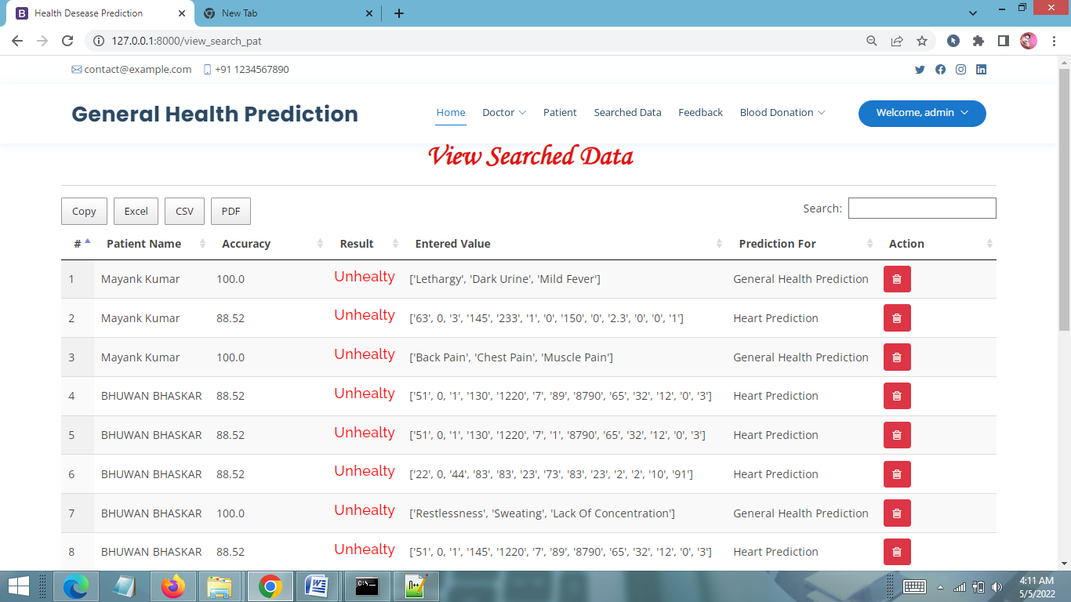
VIEW SEARCHED DATA PAGE

Slide 37
FUTURE SCOPE
Concealed learning will be extracted from the verifiable information in the proposed framework, by getting ready datasets by applying apriori calculation. Anticipating savvy wellbeing should be possible just if framework reacts that way. These datasets will be contrasted and the approaching questions and the last report will be produced utilizing Association Rule Mining. Since this proposed system will chip away at genuine chronicled information, it will give exact and productive outcomes, which will enable patients, to get the conclusion in a split second. More work should be possible later on by utilizing more informational index identified with heart sicknesses and by utilizing diverse information decrease techniques to improve the characterization.

Slide 38
FUTURE SCOPE (continue)
For better precision and expectation of heart sicknesses the datasets that will be used must be quality organized and free from special cases, inconsistencies, and missing characteristics. This web application can be additionally upgraded in an Android application. This will be accessible to clients on versatile premise and its utilization can be additionally expanded. Likewise, highlight like getting the specialist online on a visit with the goal that patients can straightforwardly converse with the concerned specialists. The modules doing malignant growth examination can be coordinated to discover how close the individual related with disease is. This will make this web application unsurprising in obvious sense.

Slide 39
CONCLUSION
It has been a great pleasure for me to work on this exciting and challenging project. This project proved good for me as it provided practical knowledge of not only programming in Python and Sqlite web based application. It also provides knowledge about the latest technology used in developing web enabled application and client server technology that will be great demand in future. This will provide better opportunities and guidance in future in developing projects independently.

Slide 40
BIBLIOGRAPHY
FOR PYTHON INSTALLATION
https://www.python.org
FOR HTML , CSS ANF PYTHON BASICS
www.w3schools.com
www.javatpoint.com
https://www.geeksforgeeks.org/python-django/
REFERENCE BOOKS
Two scoops of Django for 1.11 by Daniel Greenfeld’s and Audrey Greenfield
Lightweight Django by Elman and Mark Lavin

